Slide 1
Time Series Analysis
What is a time series model?
A time series model is a set of data points ordered in time, where time is the independent variable. These models are used to analyse and forecast the future.
However, there are other aspects that come into play when dealing with time series:
Is it stationary?
Is there a seasonality?
What Is Seasonality?
Seasonality refers to periodic fluctuations. For example, electricity consumption is high during the day and low during night, or online sales increase during Christmas before slowing down again.
What Is Stationarity?
Stationarity is an important characteristic of time series. A time series is said to be stationary if its statistical properties don’t change over time. In other words, it has a constant mean and variance.

Slide 2
How to check data is Stationary or not ?
How to Test Whether a data is Stationary: There are few statistical tests for identifying trends and stationarity in time series:
Dickey-Fuller test.
KPSS (Kwiatkowski-Phillips-Schmidt-Shin) Test.
What is the dickey-fuller test?
The Dickey-Fuller test is a statistical test used to evaluate whether a time series is stationary or not. It evaluates the null hypothesis to determine if a unit root is present. If the equation returns p>0.05, then the process is not stationary. If p<0.05, then the process is considered stationary.
KPSS (Kwiatkowski-Phillips-Schmidt-Shin) Test ?
It is another statistical test used for checking the presence of stationarity.
Null Hypothesis: The series is stationary.
Alternative Hypothesis: The series has a unit root which means the series is non-stationary.
Note: It has to be noted that the null and alternative hypothesis is the opposite for ADF and KPSS tests.

Slide 3
IMPORTANT TERMINOLOGIES
Decomposition:
A proper time series analysis demands the data to be in a stationary way but we rarely get data with stationary characteristics. Hence, the non-stationary time series converted to a stationary series by removing its trend and seasonality. This process of removing trend and seasonality is called Time series decomposition.
Differencing:
Differencing is a decomposition process through which trend and seasonality are eliminated. Here, we usually take the difference of observation with a particular instance with the previous instant.
Transformation:
Transformation is the easiest way to remove trends from a time series by converting the data into different scales using various operations like logarithms, square roots, etc. However, it is rarely implemented over differencing due to the possibility of a loss of information.

Slide 4
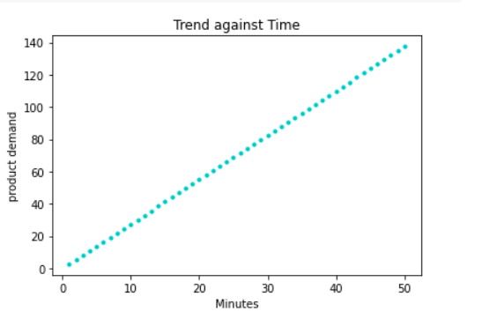
Time Series Decomposition
Time Series Decomposition is a technique to extract multiple types of variation from your dataset. There are three important components in the temporal data of a time series:
Seasonality,
Trend
Noise/Residual
Trend - This is the long-term direction of the time series. This component usually is increasing, decreasing, or constant or the increasing or decreasing value in the series.
Seasonality - This is the periodic behavior of the time series that occurs within a year. The repeating short-term cycle in the series. The plot below is an example of the seasonality component of the time series.

Slide 5
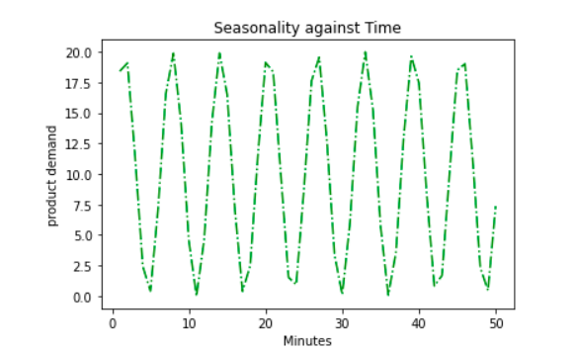
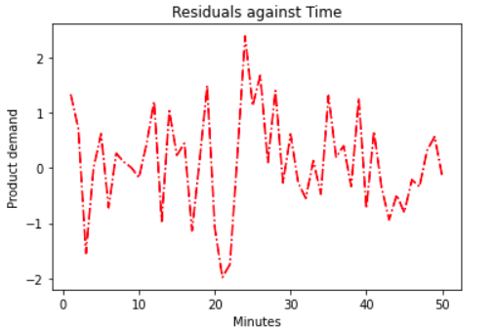
Time Series Decomposition
Seasonality plot:
Residual - This is what remains of the time series after the trend and seasonality are removed.

Slide 6
Time Series Decomposition
If data shows some seasonality (e.g. daily, weekly, quarterly, yearly) it may be useful to decompose the original time series into the sum of three components:
Y(t) = S(t) + T(t) + R(t)
Where, S(t) is the seasonal component, T(t) is the trend-cycle component, and R(t) is the remainder component.
There are several techniques to estimate such a decomposition. The most basic one is called classical decomposition and consists in:
Estimating trend T(t) through a rolling mean
Computing S(t) as the average detrended series Y(t)-T(t) for each season (e.g. for each month)
Computing the remainder series as R(t)=Y(t)-T(t)-S(t)

Slide 7


We use the following models when decomposing a time series:
Additive time series model.
Multiplicative time series model.
Additive time series model: In an additive time series, the components add together to make the time series. Here is an example of a time series using an additive model:
If the seasonality and residuals are independent of the trend in the plotted time series, we use an additive model to decompose the data.
Multiplicative time series model: In a multiplicative time series, the components multiply together to make the time series. Here is an example of a time series using a multiplicative model:
If the plotted series shows the seasonality and residuals to change with the change in trend, we use a multiplicative model to decompose our series

Slide 8
Time Series Forecasting Methods
Time series forecasting can broadly be categorized into the following categories:
Classical / Statistical Models: - Moving Averages, Exponential Smoothing, ARIMA, SARIMA, TBATS
Machine Learning: - Linear Regression, XGBoost, Random Forest, or any ML model with reduction methods
Deep Learning: - RNN, LSTM etc

Slide 9
Statistical Models:
Autoregression:
A statistical model is said to be autoregressive if it predicts future values based on previous values. Mathematically, it is denoted as –
AR (parameter) where the parameter is the number of independent variables or the count of past values considered for forecasting.
We can define AR (2) mathematically as,
Yt = B1 (Yt-1) + B2 (Yt-2)
Where,
Yt = Predicted value for next time period.
Yt-1 = Recorded value for immediate past time period.
Yt-2= Recorded value for immediate second past time period.
B1 = Coefficient of auto regression for immediate past time period value.
B2 = Coefficient of auto regression for immediate second past time period value.

Slide 10
Statistical Models:
Moving Average:
This model simply states that the next observation is the mean of all past observations. It helps largely to remove noise from outlier variations. Still, it is considered a lagging indicator that forecasts the value much after the beginning of a trend.
There are two main types of moving average that are used:
Centered moving average
Trailing Moving Average.
Centered Moving Average:
The value at time (t) is calculated as the average of raw observations at, before, and after time (t).
center_ma(t) = mean(obs(t-1), obs(t), obs(t+1))
Trailing Moving Average:
The value at time (t) is calculated as the average of the raw observations at and before the time (t).
trail_ma(t) = mean(obs(t-2), obs(t-1), obs(t))

Slide 11
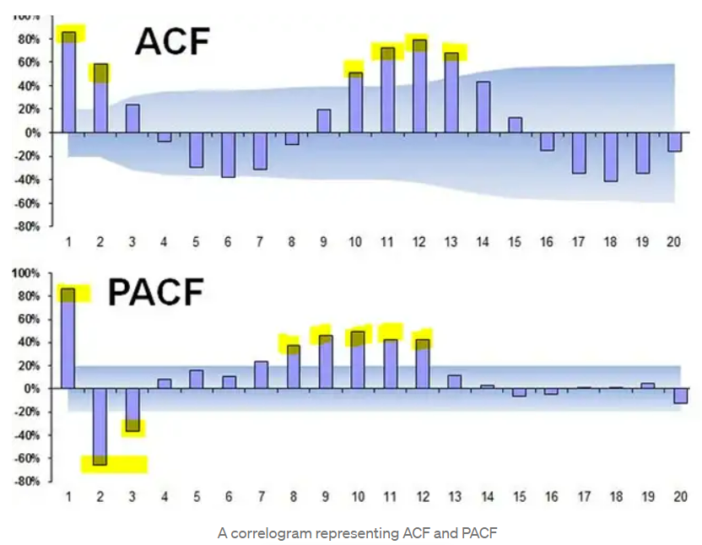
ACF (Autocorrelation Factor): It is the correlation between the observations at the current time spot and observations at the previous time spots.
PACF (Partial Auto-correlation Factor): The correlation between the observations at two time spots given that we consider both observations are correlated to the observations at the other time spots.
Choosing which model to be used: We should initially calculate the significant terms for both AR and MA using PACF and ACF respectively.
According to the above diagram,
ACF = 6 signifies that if we are using the MA model, we should use observations of 6 previous time spots which means MA (6).
PACF = 8 signifies that if we are using the AR model, we should use observations of 8 previous time spots which means AR (8).

Slide 12
ARIMA Model
ARIMA stands for Auto-regressive integrated moving average. It is nothing but the integration of both AR and MA to produce a more sophisticated and accurate model. In ARIMA,” I” stands for integrated. It represents differencing used to handle non-stationary data.
Mathematically, It is represented as ARIMA(p,d,q)
Here,
p = number of significant terms in PACF for trend (AR)
d = Order of differencing for trend
q= number of significant terms in ACF for trend (MA)
If we took 1 level differencing to detrend the data, the integration factor will be 1. Then we can represent the model combining both AR and MA as ARIMA (8, 1, 6).

Slide 13
SARIMA Model
SARIMA stands for Seasonal Autoregressive Integrated Moving Average . This is an extension of the ARIMA model which also considers the effect of seasonality. It divides the data into 2 components –
Seasonal components
Non-seasonal components
It is represented as SARIMA(p,d,q)(P,D,Q)S.
Where,
P = Number of significant terms in PACF for seasonality
D = Order of differencing for seasonality
Q = Number of significant terms in ACF for seasonality
p = Number of significant terms in PACF for trend
d = Order of differencing for trend
q= Number of significant terms in ACF for trend
S= Number of seasonal periods
Note: If data has seasonality try SARIMA and if not then go for ARIMA model.

Slide 14
Thank you

